Slide 1

Energy Consumption Dashboarding using Snowflake & Tableau
By: Shraddha Mali
Project Link: https://listwr.com/o7dQjj
Tools Used: AWS , Snowflake, SQL, Tableau, Tableau Cloud

Slide 2




Executive Summary
End-to-End Data Analytics Pipeline
Automated Data Ingestion
Developed an end-to-end data analytics pipeline for energy consumption analysis.
Automated data ingestion from AWS S3 → Snowflake → Tableau.
Dashboard Creation
Delivered Key Insights
Created dashboards to track monthly usage & cost savings across regions, countries, and energy sources.
Delivered insights on consumption patterns and savings by income level.

Slide 3
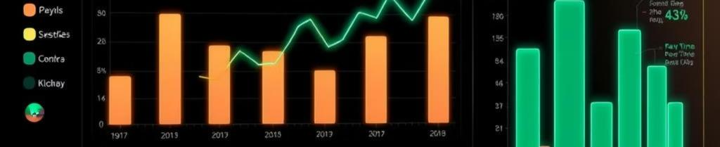
Problem Statement / Objective
Problem Statement
Objective
Rising global energy demand requires data-driven insights for efficient resource usage.
Build dashboards to track, compare, and analyze energy usage.
Lack of visibility into regional, income-based, and source-wise consumption.
Identify patterns to improve sustainability and cost-saving strategies.

Slide 4

Dataset Description
Source: Renewable Energy Usage dataset (CSV) uploaded to AWS S3.
Size: Approx. 1000+ data rows.
Key Fields: Region, Country, Income Level, Energy Source, Monthly Usage, Cost Savings.
Data Type: Time-series + categorical + numerical.

Slide 5

Data Pipeline Workflow
Amazon S3 bucket created for dataset storage.
Ingest to S3 & IAM role Configuration
Configured IAM role & trust policy for Snowflake integration.
Load to Snowflake
Loaded dataset into Snowflake SQL worksheet.
SQL Transform
Performed transformations in Snowflake.
Dashboarding & Publish to Tableau
Connected data to Tableau dashboards & published to Tableau Cloud.

Slide 6

Data Transformations
Adjusted Monthly Usage by Income Level
Adjusted Cost Savings by Income Level
+10% (Low Income)
–10% (Low Income)
+20% (Middle Income)
–20% (Middle Income)
+30% (High Income)
–30% (High Income)
Data Cleaning
Cleaned missing values & standardized fields.

Slide 7
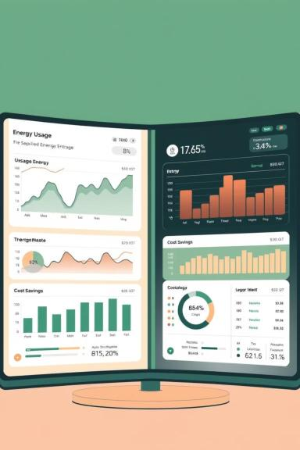
Dashboards & Insights
Dashboard 1: Monthly Usage Analysis
Dashboard 2: Cost Savings Analysis
By Region, Country, Energy Source
By Region, Country, Energy Source
Key Insights:
High-income regions show higher consumption growth rates.
Low-income groups achieve better cost efficiency per unit of energy.
Renewable adoption varies strongly by region & source (e.g., solar/wind dominance).

Slide 8
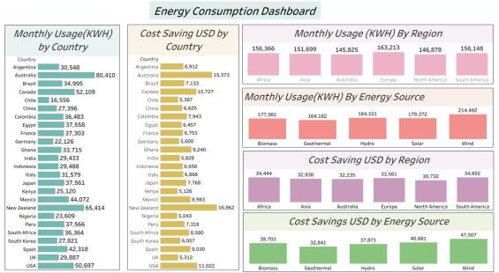
Results :
Scalable Cloud-Based Pipeline
Built a scalable cloud-based pipeline (S3 → Snowflake → Tableau Cloud).
Interactive Dashboards
Delivered interactive dashboards for energy stakeholders.
Income-Based Demand Patterns
Insights highlight income-based demand patterns & optimization opportunities.

Slide 9

Possible Impact & Business Value
Improved Visibility
Data-Driven Decisions
Improved visibility into renewable energy adoption.
Supports data-driven decisions for governments & energy companies.
Scalable Solution
Scalable solution for future datasets & advanced analytics (e.g., ML forecasting).

Slide 10

Challenges & Learnings
Challenges:
Learnings:
Cloud integration setup
Hands-on with end-to-end cloud data pipelines.
Trust policy configuration
Stronger SQL + Tableau Cloud skills.

Slide 11
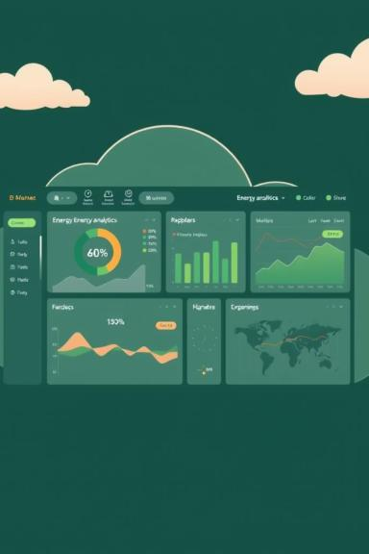
Conclusion
Successfully developed a cloud-to-dashboard solution for energy analytics.
Showed that integrating cloud platforms with BI tools delivers scalable, actionable insights.

